Slide 1
Automatic Semantic Segmentation and Cloud Cover Estimation of Ground-Based Whole-Sky Images Using Deep Learning and Graph-Based Cuts
Cayley Cruickshank DeFontes
EN.625.492: Probabilistic Graphical Models, Spring 2018
Johns Hopkins University, Whiting School of Engineering

Slide 2
Agenda
Background of Semantic Segmentation
Defining Semantic Segmentation for Computer Vision
General Survey of Segmentation Taxonomies
Overview of Project Goals & Objective
Data & Methodologies
SWIMSEG Whole-Sky Cloud Imaging
Deep Learning with Convolutional Neural Networks (CNN)
Segmentation Pipeline
Incorporating NASA GLOBE Clouds Arctic Whole-Sky Imagery Data
Foreground Segmentation with Graph-Cuts
Analysis of Results
Implementation

Slide 3
What is Semantic Segmentation?
Semantic Segmentation, also known as pixel-wise classification, combines two goals:
Partition an image into semantically meaningful parts.
Assign each pixel to one of n pre-determined classes or categories.
Figure 1: Semantic Segmentation of Objects in Traffic Scene
Source: Kundu, et al. (2016). Feature Space Optimization for Semantic Video Segmentation. CVPR.
Section I: Background

Slide 4
What Differentiates Semantic Segmentation from Other Image Classification Tasks?
Computer Vision tasks incorporate a variety of object classification and localization tasks. This includes, but is not limited to:
Figure 2: Sample of Computer Vision Tasks
Source: Li, et al. (2016) cs231n, Lecture 8 - Slide 8, Spatial Localization & Detection. Stanford University.
Section I: Background

Slide 5
Overview of Project Goals & Objectives
The goal of this project is two-fold:
Train a deep learning network to perform semantic segmentation on cloud boundaries in ground-based, whole-sky images in order to estimate sky-cloud cover given a pixel-wise classification.
Perform foreground subtraction on NASA GLOBE Clouds Program Arctic Research citizen-science ground-based images in order to perform semantic segmentation on sky-cloud regions for sky-cloud cover estimation.
Section II: Project Overview

Slide 6
Overview of Data
Images were obtained from the Vision & Interactive Group’s Singapore Whole-Sky Imaging Segmentation Imaging Database (SWIMSEG) and NASA GLOBE Clouds Program Arctic research citizen science imaging data. The library specifications are as follows:
Image Dataset | Content Summary | Number of Images | Image Dimensions
SWIMSEG | Sky/cloud image patches and corresponding binary segmentation maps | 1013* | 224 x 224
NASA GLOBE Clouds Arctic Research Citizen-Science Imaging Data | Ground-based images containing foreground, sky, and clouds with corresponding binary segmentation maps | 100* | Varies
*Image augmentation was performed; random cropping was performed for each training epoch.
Section III: Data & Methodologies

Slide 7
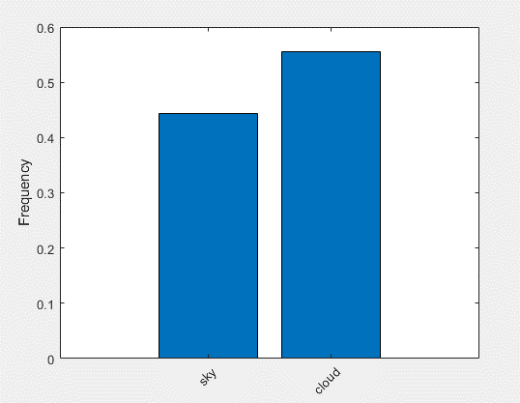
Overview of Data
Figure 3: Relative Class Frequency by Pixel Obtained from SWIMSEG Binary Ground Truth Maps
Class Name | Pixel Count | Image Pixel Count
Sky | 2.3115e+07 | 5.0828e+07
Cloud | 2.8919e+07 | 5.3036e+07
The distribution of classes found in SWIMSEG ground truth maps is approximately 45:55 for sky and cloud pixel labels, respectively.
This near-even representation of classes reduces the chance of over/under learning a given class during training.
Section III: Data & Methodologies

Slide 8
Overview of Methodologies
The implementation of this project can be divided into two distinct parts:
Part I:
Train a pixel-wise classifier to segment SWIMSEG imagery into ’sky’ and ‘cloud’ categories in order to estimate sky-cloud cover in SWIMSEG images.
Part II:
Perform foreground subtraction on raw images from NASA GLOBE Clouds Arctic Research images in order to pre-process images for input to pixel-wise classifier. Re-train deep learning network to recognize ‘background’ regions in order to correctly segment and estimate sky-cloud cover areas within image.
Section III: Data & Methodologies

Slide 9
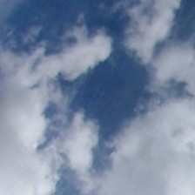
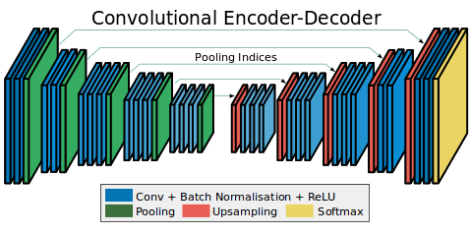
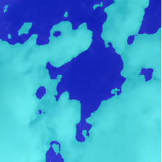
Pixel-Wise Classifier for Semantic Segmentation of SWIMSEG Images
Figure 4: Semantic Segmentation Convolutional Encoder-Decoder Classification Pipeline
Input: Raw RGB Images, 224 x 224 x 3
Output: Semantic Segmentation Mask
Sources: Badrinarayanan et al. (2016). SegNet: A Deep Convolutional Encoder-Decoder Architecture for Image Segmentation. CVPR.¹
Dev, et al. (2017). Color-based segmentation of sky/cloud images from ground-based cameras. IEEE Journal of Selected Topics in Applied Earth Observations and Remote Sensing.²
Section III: Data & Methodologies

Slide 10
Sky-Cloud Semantic Segmentation Network Specifications
# | Layer Name | Details
1 | Image Input | RGB images (224 x 224 x 3) with ‘zero-center’ normalization
2 | Convolution | 224 (3 x 3 x 3) convolutions with stride [1 1] and padding [1 1 1 1]
3 | ReLU | Rectified Linear Unit
4 | Max Pooling | (2 x 2) Max Pooling with stride [2 2] and padding [0 0 0 0]
5 | Convolution | 224 (3 x 3 x 224) convolutions with stride [1 1] and padding [1 1 1 1]
6 | ReLU | Rectified Linear Unit
7 | Max Pooling | (2 x 2) Max Pooling with stride [2 2] and padding [0 0 0 0]
8 | Transposed Convolution | 224 (4 x4 x 224) transposed convolutions with stride [2 2] and output cropping [1 1]
9 | ReLU | Rectified Linear Unit
10 | Transposed Convolution | 224 (4 x 4 x 224) transposed convolutions with stride [2 2] and output cropping [1 1]
11 | ReLU | Rectified Linear Unit
12 | Convolution | 2 (1 x 1 x 224) convolutions with stride [1 1] and padding [0 0 0 0]
13 | Softmax | Softmax Activation
14 | Pixel Classification | Cross-entropy loss with two classes: “sky”, “cloud”
Section III: Data & Methodologies

Slide 11
Pixel-Wise Classifier for Semantic Segmentation of SWIMSEG Images
Hyperparameters
Adam Optimizer
Initial Learning Rate = 1x 10 e-4
Maximum Epochs = 150
Mini Batch Size = 4
Training Specifications
Trained on 'GeForce GTX 760’ GPU Device
MATLAB v. R2018a
OS: Windows 10, 64-bit
Training time for the pixel-wise classifier took approximately 8 hours on the GPU device listed above.
Section III: Data & Methodologies

Slide 12
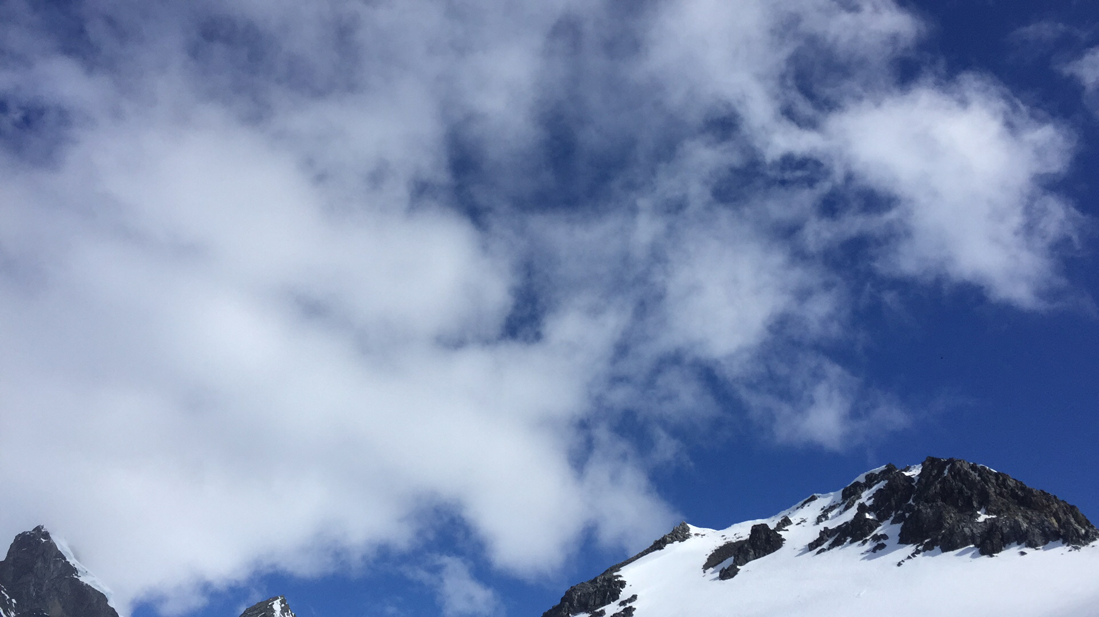
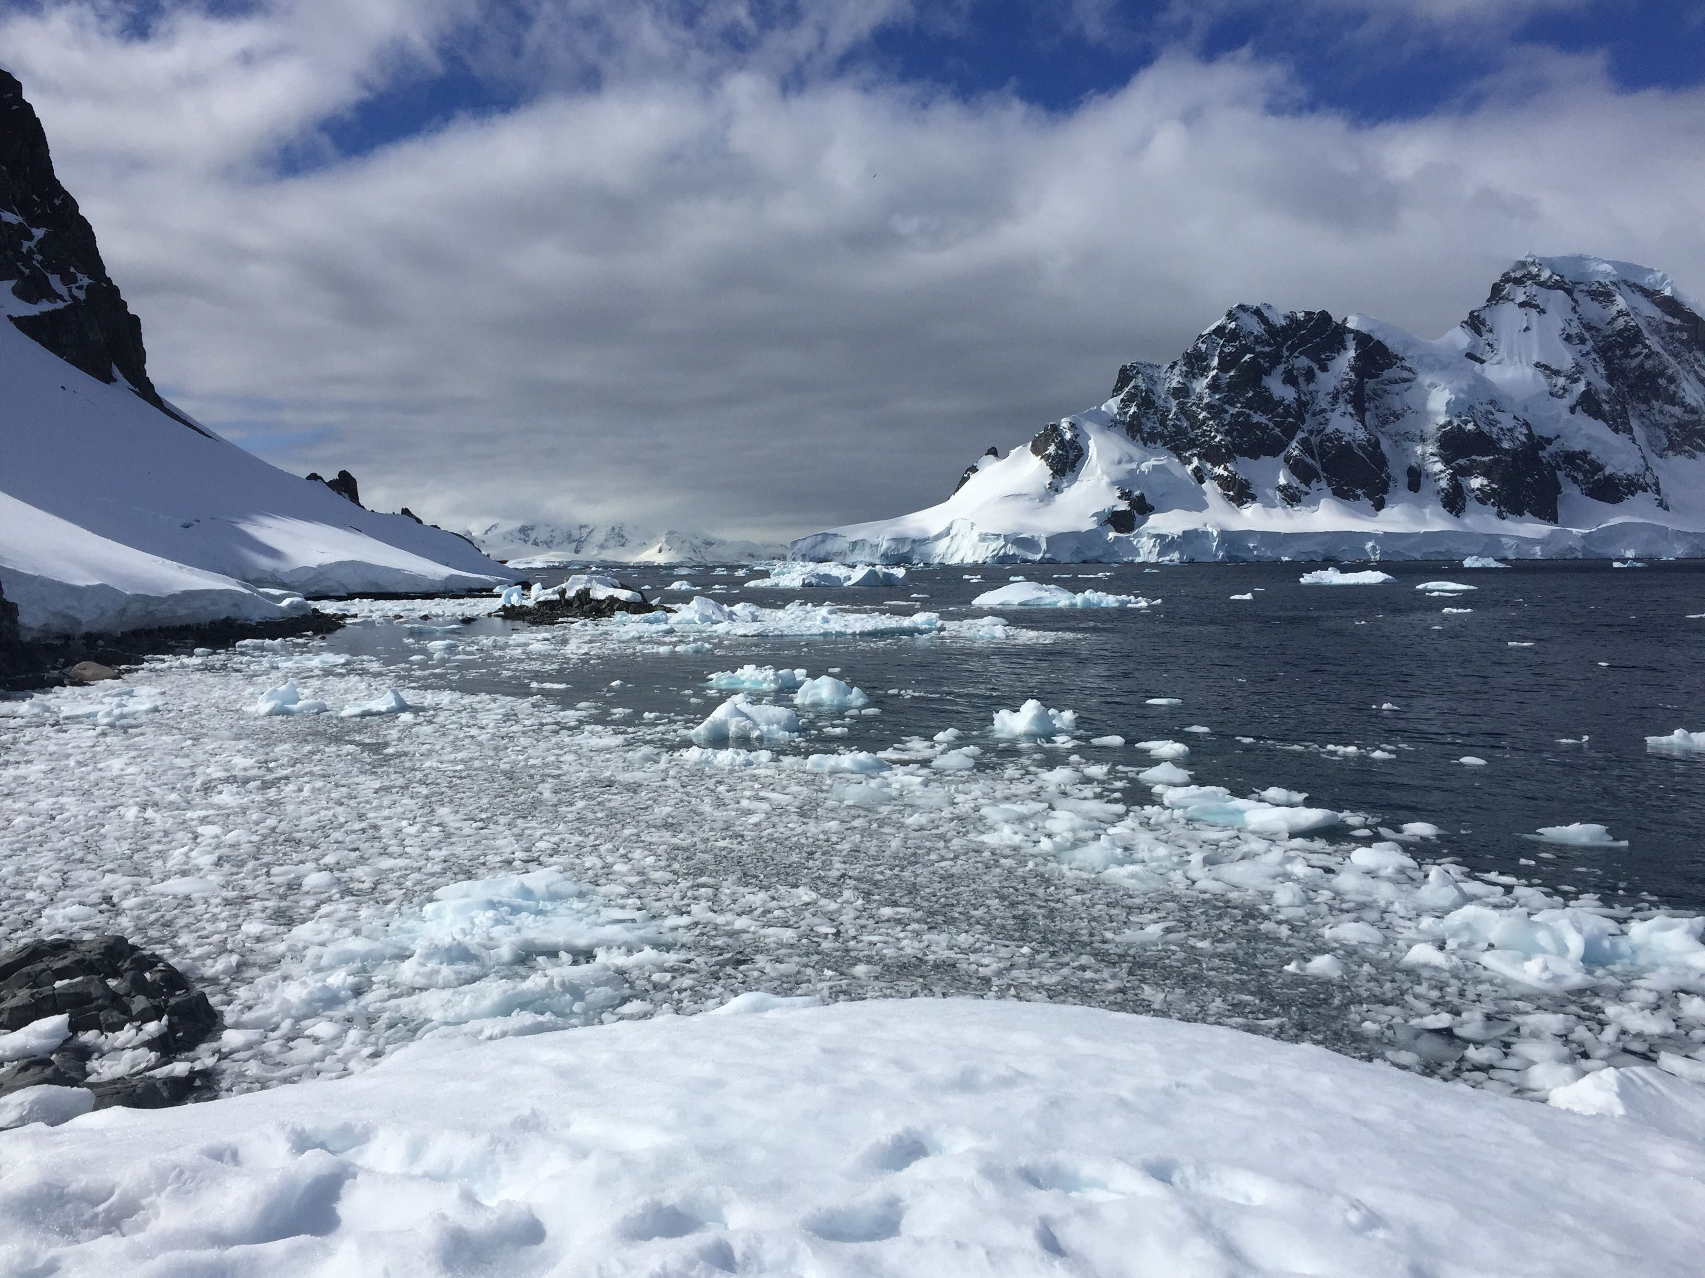
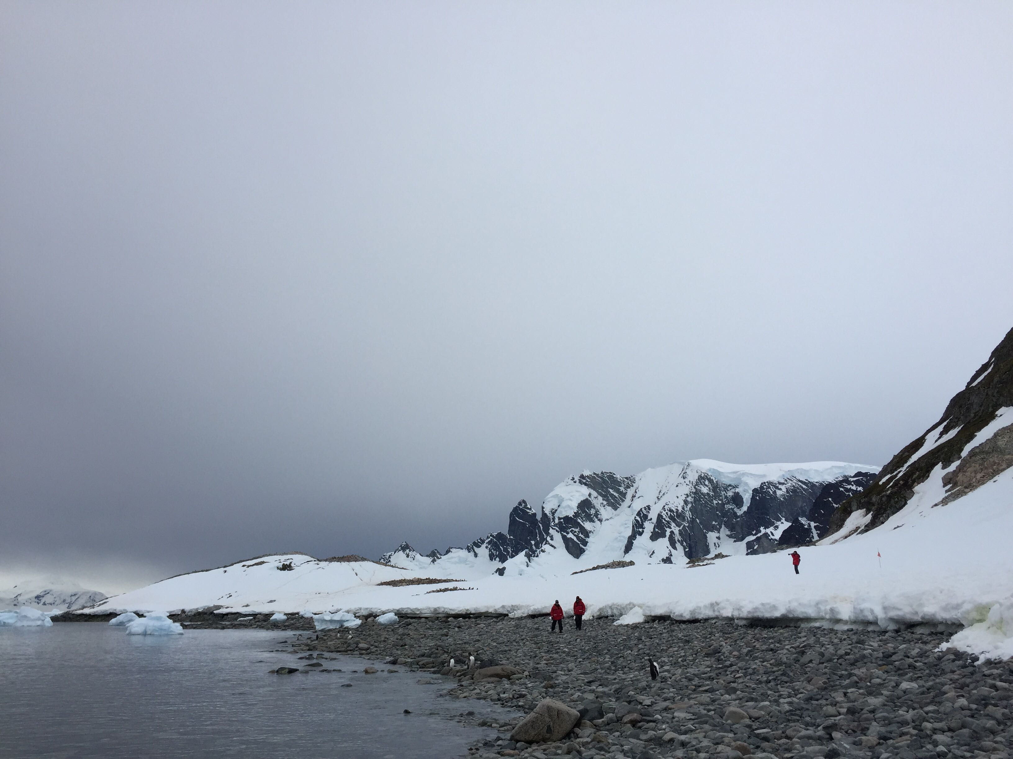
Pixel-Wise Classifier for Semantic Segmentation of NASA GLOBE Clouds Images
Q: How can we use this semantic segmentation network to estimate sky-cloud cover on other images, particularly those used in current professional role?
A: In order to perform semantic segmentation of sky-cloud regions on NASA GLOBE Clouds Program citizen science Arctic research images, we must perform background subtraction to mask objects in foreground in images, pictured below.
Figure 5: Sample Images, NASA GLOBE Clouds Program Citizen Science Arctic Research
Source: NASA GLOBE Clouds Visualization System, 2018.
Section III: Data & Methodologies

Slide 13
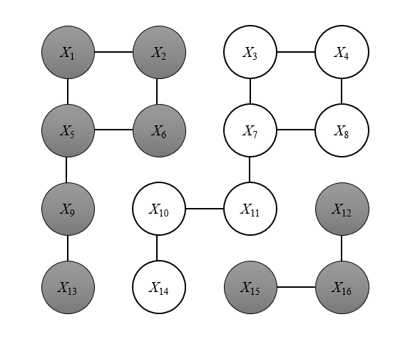
Graph-Cuts for Foreground Segmentation
Graph Cuts is a method of interactive binary partitioning of the image space given some user ‘seed’ of preliminary information. By representing the image as a random field, the Graph Cut algorithm encodes user input ‘scribbles’ to learn parameters for optimal partitioning of the image space. The optimal partition can be computed my minimizing the energy associated with performing a series of ‘cuts’.
We wish to construct an optimal partition such that nodes are partitioned into disjoint subsets (foreground, background) in a way that maximizing the measure of similarity within in-group nodes and maximizes the measure of dissimilarity between disjoint groups.
Figure 6: Transformation of Image into Weighted Lattice Structure and Computed Node Partition
Section III: Data & Methodologies

Slide 14
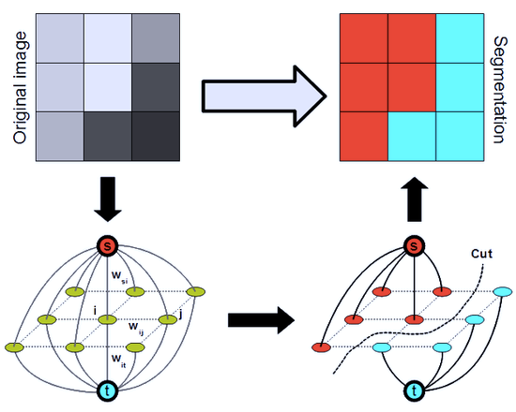
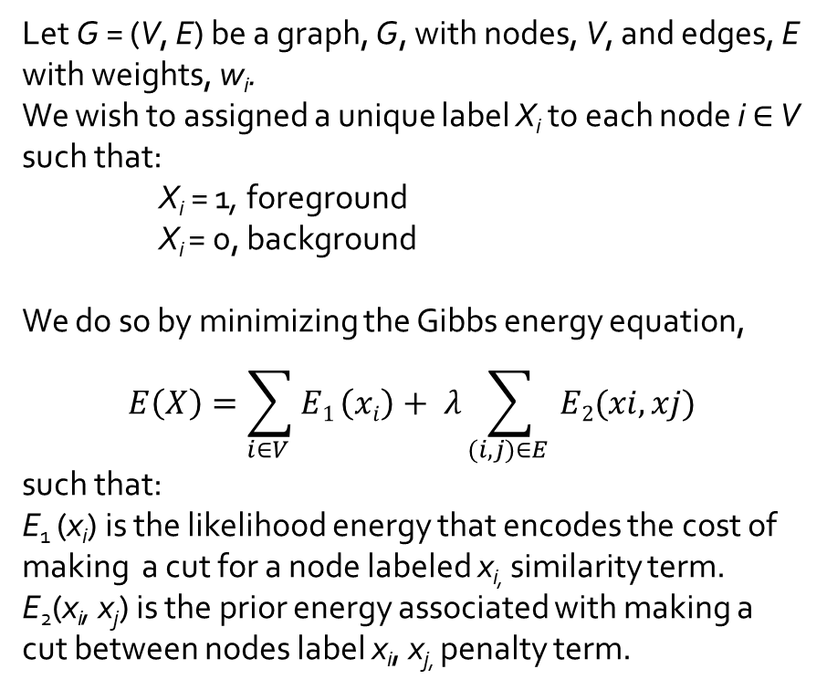
Graph-Cuts for Foreground Segmentation
Figure 7: Illustration of Graph-Cut Method
Let G = (V, E) be a graph, G, with nodes, V, and edges, E with weights, w_{i}.
We wish to assigned a unique label X_{i} to each node i $∈$ V such that:
X_{i} = 1, foreground
X_{i} = 0, background
We do so by minimizing the Gibbs energy equation,
$$E\left(X\right)=\sum_{i∈V }^{i}{E1}\left(xi\right)+ λ\sum_{(i, j)∈E }{E2(xi, xj)}$$
such that:
E₁ (x_{i}) is the likelihood energy that encodes the cost of making a cut for a node labeled x_{i,} similarity term.
E₂(x_{i}, x_{j}) is the prior energy associated with making a cut between nodes label x_{i}, x_{j,} penalty term.
Source: Boykov, et al. (2004). An Experimental Comparison of Min-Cut/Max-Flow Algorithms for Energy Minimization in Vision. IEEE, Transactions on PAMI.
Section III: Data & Methodologies

Slide 15
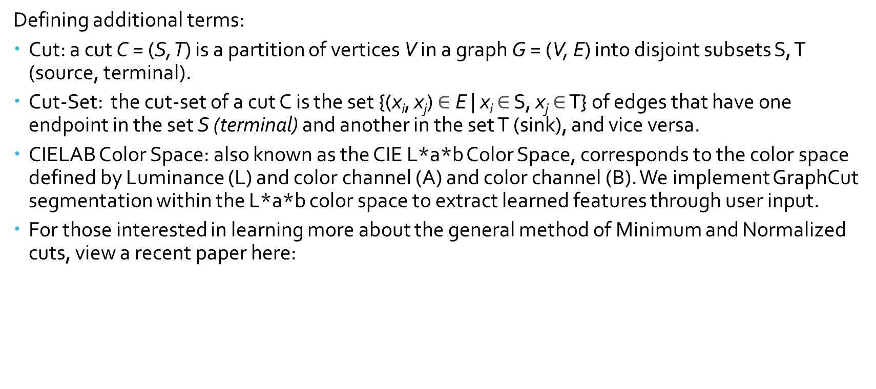
Graph-Cuts for Foreground Segmentation
Defining additional terms:
Cut: a cut C = (S, T) is a partition of vertices V in a graph G = (V, E) into disjoint subsets S, T (source, terminal).
Cut-Set: the cut-set of a cut C is the set {(x_{i}, x_{j}) $∈$ E | x_{i} $∈$ S, x_{j} $∈$ T} of edges that have one endpoint in the set S (terminal) and another in the set T (sink), and vice versa.
CIELAB Color Space: also known as the CIE L*a*b Color Space, corresponds to the color space defined by Luminance (L) and color channel (A) and color channel (B). We implement GraphCut segmentation within the L*a*b color space to extract learned features through user input.
For those interested in learning more about the general method of Minimum and Normalized cuts, view a recent paper here:
Section III: Data & Methodologies

Slide 16
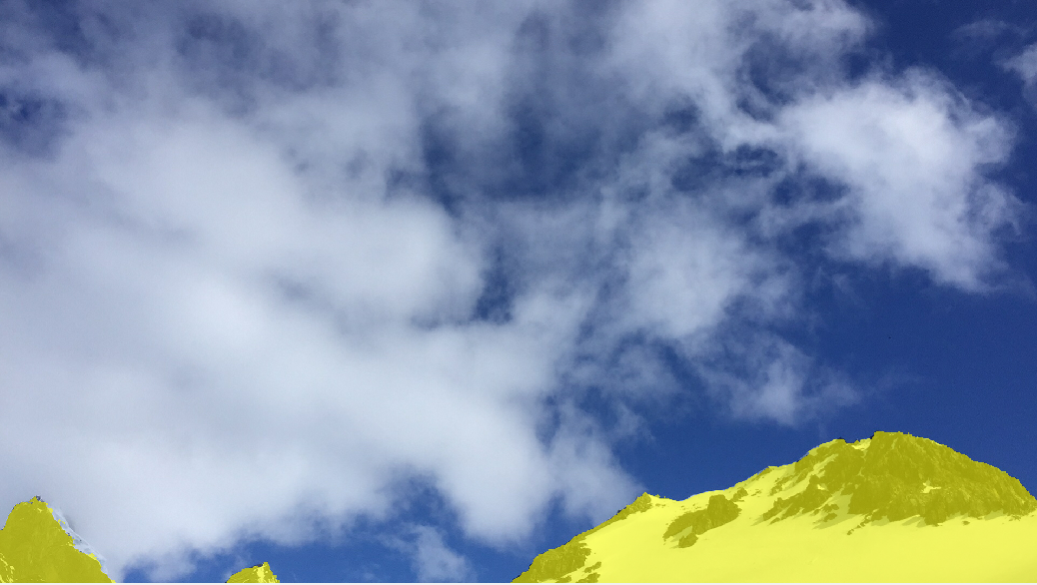
Figure 8: Sample Image Before and After Graph-Cut Foreground Subtraction
Source: NASA GLOBE Clouds Visualization System, 2018.
Section III: Data & Methodologies

Slide 17
Sky-Cloud-Background Semantic Segmentation Network Specifications
# | Layer Name | Details
1 | Image Input | RGB images (224 x 224 x 3) with ‘zero-center’ normalization
2 | Convolution | 224 (3 x 3 x 3) convolutions with stride [1 1] and padding [1 1 1 1]
3 | ReLU | Rectified Linear Unit
4 | Max Pooling | (2 x 2) Max Pooling with stride [2 2] and padding [0 0 0 0]
5 | Convolution | 224 (3 x 3 x 224) convolutions with stride [1 1] and padding [1 1 1 1]
6 | ReLU | Rectified Linear Unit
7 | Max Pooling | (2 x 2) Max Pooling with stride [2 2] and padding [0 0 0 0]
8 | Transposed Convolution | 224 (4 x4 x 224) transposed convolutions with stride [2 2] and output cropping [1 1]
9 | ReLU | Rectified Linear Unit
10 | Transposed Convolution | 224 (4 x 4 x 224) transposed convolutions with stride [2 2] and output cropping [1 1]
11 | ReLU | Rectified Linear Unit
12 | Convolution | 3 (1 x 1 x 224) convolutions with stride [1 1] and padding [0 0 0 0]
13 | Softmax | Softmax Activation
14 | Pixel Classification | Cross-entropy loss with three classes: “sky”, “cloud”, “background”
Section III: Data & Methodologies

Slide 18
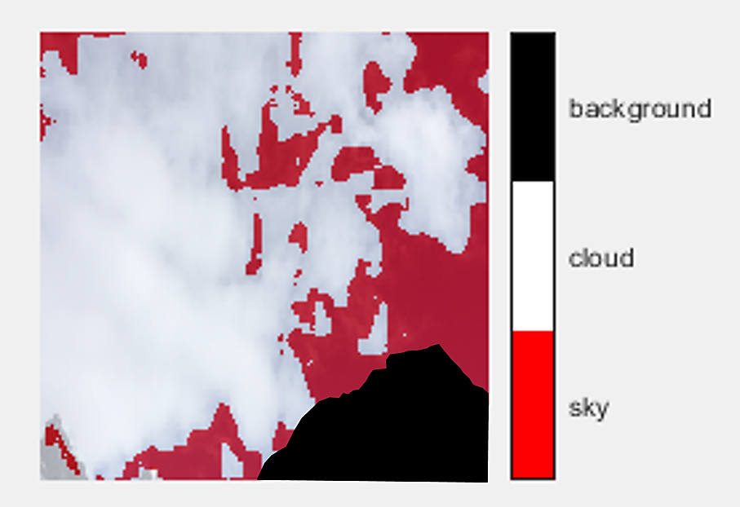
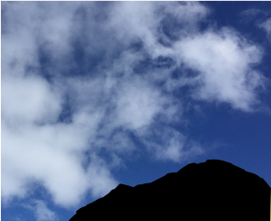
Pixel-Wise Classifier for Semantic Segmentation of SWIMSEG Images
Input: Raw RGB Images, n x m x 3
Pre-Processing: Resize Image to
224 x 224 x 224, Mask Foreground
with Graph Cut algorithm
Output: Semantic Segmentation Mask
Source: Badrinarayanan et al. (2016). SegNet: A Deep Convolutional Encoder-Decoder Architecture for Image Segmentation. CVPR.
Section III: Data & Methodologies

Slide 19
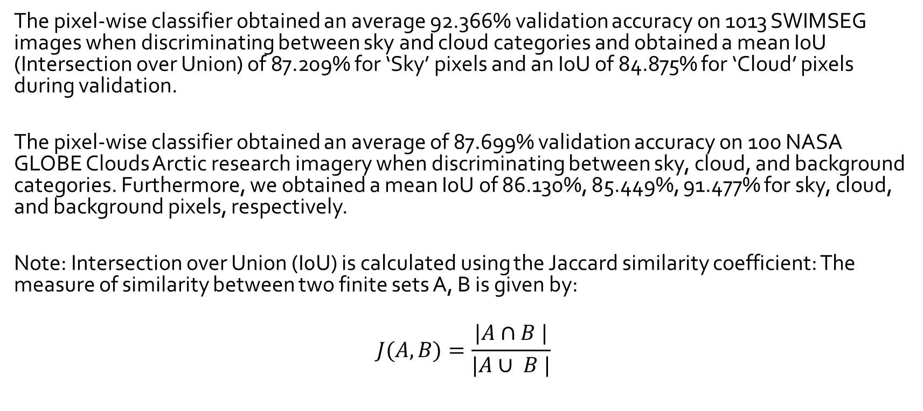
Results
The pixel-wise classifier obtained an average 92.366% validation accuracy on 1013 SWIMSEG images when discriminating between sky and cloud categories and obtained a mean IoU (Intersection over Union) of 87.209% for ‘Sky’ pixels and an IoU of 84.875% for ‘Cloud’ pixels during validation.
The pixel-wise classifier obtained an average of 87.699% validation accuracy on 100 NASA GLOBE Clouds Arctic research imagery when discriminating between sky, cloud, and background categories. Furthermore, we obtained a mean IoU of 86.130%, 85.449%, 91.477% for sky, cloud, and background pixels, respectively.
Note: Intersection over Union (I0U) is calculated using the Jaccard similarity coefficient: The measure of similarity between two finite sets A, B is given by:
$$J(A, B)=\frac{|A∩B |}{|A∪ B |}$$
Section IV: Results

Slide 20
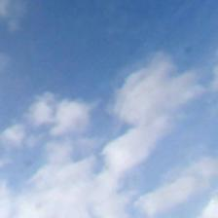

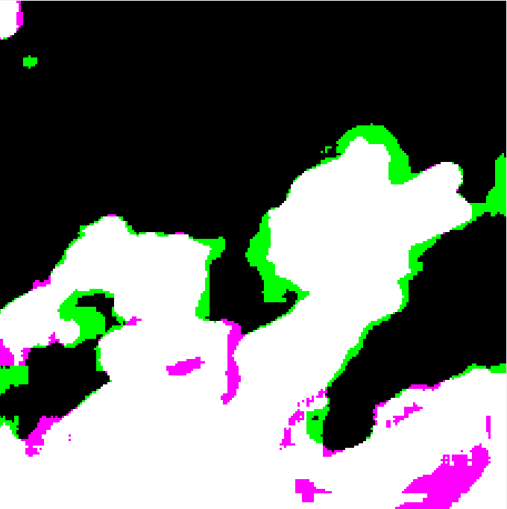
Results
The figures below depict the segmentation results on a sample SWIMSEG image using the 2-class pixel-wise classifier. The raw RGB image (left) has a binary ground truth map (middle). Comparing the results of the segmentation to the ground truth, we can observe regions that contain Type I error in green (false positive) and regions containing Type II error (false negative).
Figure 9: Visualization of Type I, II Errors in Segmentation Result
Section IV: Results

Slide 21
How to Use:
To perform semantic segmentation on SWIMSEG data:
Open GitHub repository, GraphCut+CNN located at: cdefonte\GraphCut-CNN
SWIMSEG data is located at: GraphCut_CNN\2_classes folder
Contains: Demo, training files, relevant functions, sample image
Demo: demo_2classes.m
Training: training_2classes.m
NASA GLOBE Clouds data is located at: GraphCut_CNN\3_classes folder
Contains: Demo, training files, relevant functions, sample image
Demo: demo_3classes.m
Training: training_3classes.m
There is no need to edit the files to run the demo. Training files require users to request the SWIMSEG images from the link provided. Requests for NASA GLOBE Clouds images can be made to cayley (dot)a(dot)defontes(at)nasa(dot)gov.
Section V: Implementation

